Slide 1
Hospital preparedness
(triage, surge capacity, supplies)
Dr. K. Ravi Kumar
Senior Regional director

Slide 2
Issues
Anticipatory measures
Management of the cases
Safety of the staff - healthcare workers
Safety of the other patients /other people

Slide 3
Is safety entitled?
Health workers are at the front line of any outbreak response and as such are exposed to hazards that put them at risk of infection
Hazards include pathogen exposure, long working hours, psychological distress, fatigue, occupational burnout, stigma, and physical and psychological violence.
Understand the rights and responsibilities of health workers, including specific measures needed to protect occupational safety and health.

Slide 4
What are the rights ? What do we provide?
Assume overall responsibility to ensure that all necessary preventive and protective measures are taken to minimize occupational safety and health risks;
Provide information, instruction and training on occupational safety and health, including;
    Refresher training on infection prevention and control (IPC); and
o Use, putting on, taking off and disposal of personal protective equipment (PPE);
Provide adequate IPC and PPE supplies (masks, gloves, goggles, gowns, hand sanitizer, soap and water, cleaning supplies) in sufficient quantity to healthcare or other staff caring for suspected or confirmed
Zero-tolerance policies towards workplace violence and harassment.

Slide 5
What more ?
Familiarize personnel with technical updates on COVID-19 and provide appropriate tools to assess, triage, test and treat patients and to share infection prevention and control information with patients and the public;
Right to compensation, rehabilitation and curative services if infected with COVID-19 following exposure in the workplace.

Slide 6
What should Health workers do ?
Use provided protocols to assess, triage and treat patients;
Treat patients with respect, compassion and dignity;
Maintain patient confidentiality;
Put on, use, take off and dispose of personal protective equipment properly;
Self-monitor for signs of illness and self-isolate or report illness to managers, if it occurs;

Slide 7
What do we require to prepare ?
Assess training needs, make a training plan and start training;
Assess requirement of masks, gloves, PPE, sanitizers etc. and procure;
Identify hospitals; Inspect them;
Set up isolation facilities;

Slide 9
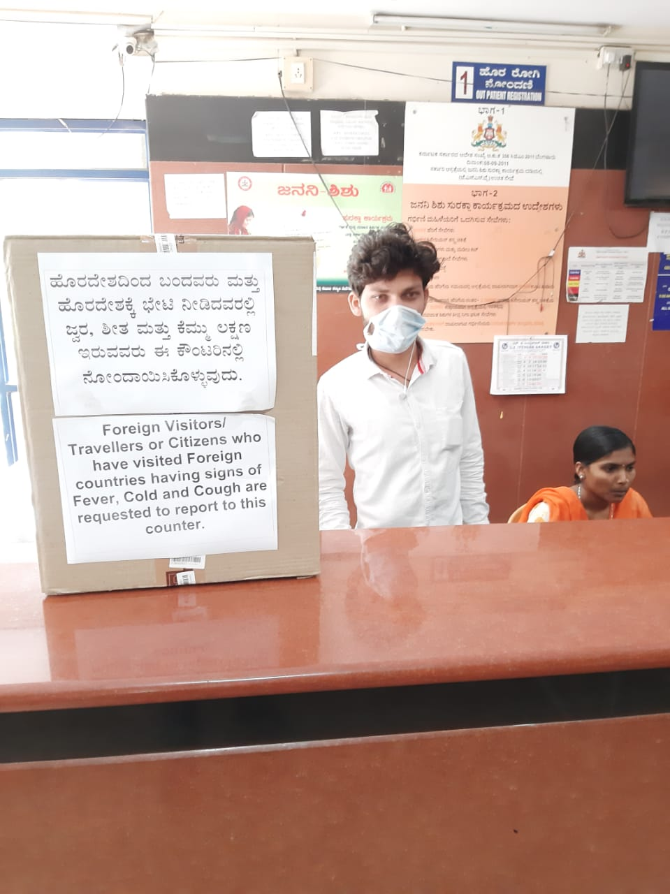

Slide 22
Thanks

